Slide 1
Statement Classifier
A Multiclass Classification
Pazhamalai Natarajan

Slide 2


Statement Classifier - What we are trying to solve?
Objective
Classify the statement into the predefined categories and their confidence score
Model
Classifier Model

Slide 3
Model Flow
TF-IDF Vectors
Topic Classifier
Sentence
(Text)
Classifier

Slide 4
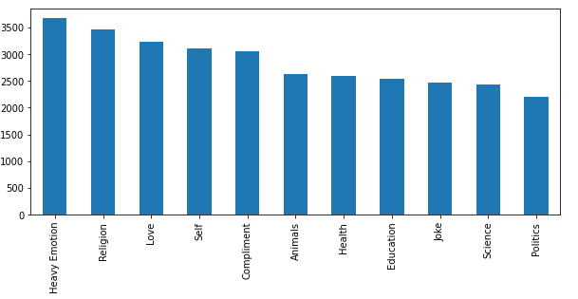
Topic Distribution
Distribution of the topic is not much skewed and hence log is not needed.

Slide 5
Model Selection Metrics
Model | Accuracy
LogisticRegression | 0.54
LinearSVC | 0.52
MultinomialNB | 0.52
Randomforest | 0.29
As this multiclass we are comparing the accuracy for the different models and fighting it to train.Logistic Regression out scores all other we are training it with this one

Slide 6
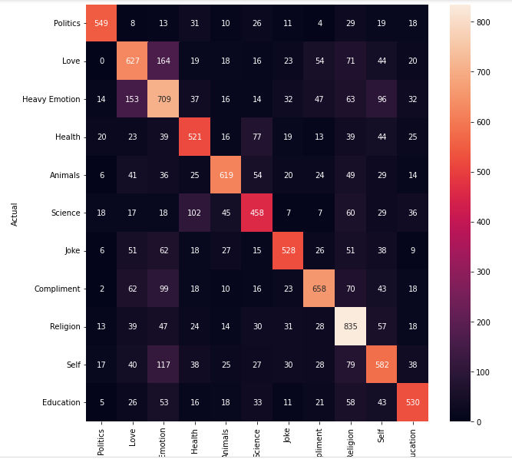
Model Metrics - confusion Matrix in Heat map

Slide 7
Validation Metrics
Class | Precision | Recall | F1 Score
Animals | 0.63 | 0.64 | 0.63
Compliment | 0.72 | 0.66 | 0.69
Education | 0.66 | 0.55 | 0.60
Health | 0.57 | 0.58 | 0.58
Heavy Emotion | 0.51 | 0.56 | 0.53
Joke | 0.68 | 0.68 | 0.68
Love | 0.60 | 0.58 | 0.59
Politics | 0.82 | 0.77 | 0.80
Religion | 0.71 | 0.69 | 0.70
Science | 0.57 | 0.52 | 0.55
Self | 0.45 | 0.55 | 0.49
 | Macro Avg | Weighted Avg
Precision | 0.63 | 0.62
Recall | 0.62 | 0.61
F1 Score | 0.62 | 0.61
Accuracy | 0.64

